Slide 1
MODULE 5: Functions and Modularity
PTP5.101: Programmer's Mindset: Problem Solving and Programming

Slide 2
Functions
Function definition
Calling a Function
Passing arguments to a Function
Passing arguments and returning values.

Slide 3
Introduction
In programming, the main difference between functions and modularity is that functions are modules that perform a single task. In contrast, modularity is a software design technique that breaks down a program into independent modules.
Functions:
A function is a module that performs a single task and returns a value to the program that calls it. Functions can be called multiple times within a program with different inputs.

Slide 4
Introduction
Modularity:
A Modularity is a software design technique that breaks down a program into independent modules. Each module contains everything needed to execute one aspect of the program's functionality. Modularity promotes code reuse on a larger scale than functions.

Slide 5
Functions in Scratch
In Scratch programming, a function is a block of code that performs a specific task and can be reused throughout a project.
My blocks are one of the 9 categories of blocks in Scratch. My Blocks are pink-coloured blocks that specifically hold the procedure for selected sprites. They are the combination of more than one block that can be grouped to form a single block
Purpose: Functions help organize code and make it more efficient. They can also make code more readable with clear function names.

Slide 6
Functions in Scratch
Uses of My Blocks in Scratch
My Blocks help in organizing and simplifying your code. My Blocks give the users the ability to combine more than one block to ease the coding process.
My Blocks also allows running the code and scripts without screen fresh, that is, it eliminates the extremely short period between the running processes of two blocks. It enhances the working of sprites and code.

Slide 7
Functions in Scratch
How to create a Function
To create a function in Scratch, you need to follow the below steps:
Step 1: Click on the “My Blocks” button which is a pink-colored circle available on the left side of the screen.
Step 2: Then click on a box saying “Make a Block” to create your own customized block.
Step 3: Once you click on the “Make a Block” option, the following screen will show up allowing the user to make a procedure.

Slide 8
Functions in Scratch
Step 4: To add a number or text to your customized block, click on the first option of the three available options present at the extreme left.
Step 5: To add a Boolean value to your customized block, click on the second option of the three available options present in the middle.
Step 6: To add a label to your customized block, click on the third option of the three available options present at the extreme right.
Step 7: After creating the block and giving it a name, click on “OK” to move forward.

Slide 9
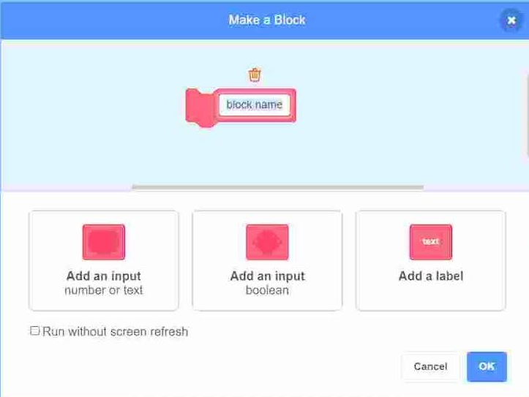
Functions in Scratch
Step 8: If you want to run your block without the screen fresh, click on the tick box.
Step 9: Once you click on “OK”, the new block will appear in the block palette and an empty definition will appear in the coding area.

Slide 10
Functions in Scratch
How to edit and delete My Blocks in Scratch:
To edit a My Block, right-click on the block and select “Edit”. This will take you to the initial My Block creation screen. Now, you can edit the name of the block or add the input values or labels as per the requirement.
To delete a My Block, right-click on the block and select “Delete”. This will simply delete the block.

Slide 11
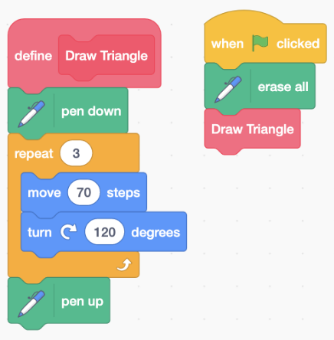
Creating and Calling a Function
Example: Create and Invoke a Function

Slide 12
Functions with Parameters
What if I want to make different size triangles?
Do I need to write a pile of different functions?
No!!!
Solution:
We can modify our function to include a parameter block (input text or number) so that we can use the same function to make different size triangles within our program.
When the program is called, all we have to do is specify a size

Slide 13
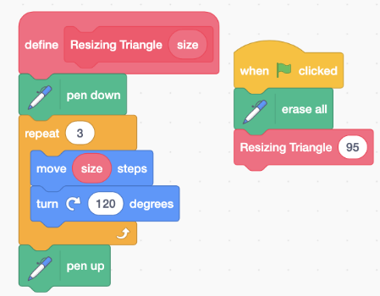
Functions with Parameters
Example:

Slide 14
Functions with Parameters
Task:
Similar to the triangle function, you can create a square function.
Rather than making 3 square functions (1 for each size), it is easier to create our function to have a parameter block that utilizes a variable size
Each time we want to make a new square, all we do is add the size of the square we want to draw

Slide 15
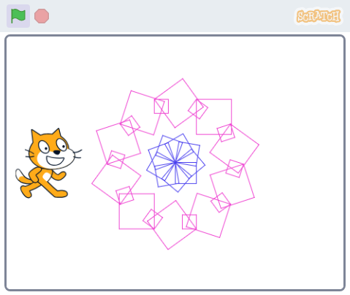
Functions with Parameters

Slide 16
Modularity
One
Two

